Slide 1
Career orientation in elementary and secondary VET schools in Serbia
Political partners:
Ministry of Education, Science and Technological Development and Ministry of youth and sports
Time frame:
Preparation 2009-2011
Implementation: 2011-2014
Implementation in VET schools: 2016-2017
Geographical coverage: nation wide
Target groups: primary/secondary school students; youth out of school system, youth from vulnerable groups

Slide 2
Challenges and approach in schools and youth offices
The basis for career decision is a challenge for youth and family, school and employers
High rate of unemployed (41.6-51.8%) and inactive youth (72.8% April 2014)
Approach
From team to whole school approach
Creating community support
Peer approach

Slide 3
- Development of the CO and CG program - Establishment of CO and CG structure and its capacity building - Establishment and development of competencies for mentorship and partnerships in local communities - Catalogue and calendar of CO and CG services in local communities - Communication platforms: www.profesionalnaorijentacija.org/www.mojaposla.rs - Evidence based monitoring and evaluation system
Main tasks

Slide 4
Self-awareness
Information about professions
Education possibilities
Real encounters
Decision on future career
CAREER ORIENTATION IS LIFE ORIENTATION!
five-phases dynamic model

Slide 5
Capacity building
Teachers/professionals and practitioners in education
Students of humanistic sciences as peer counsellors
Trainings and mentoring

Slide 6
Implementation strategy

Slide 7
Results
› 1,097 schools in Serbia received training; 3,048 trained teachers and associates;
› 1,061 primary schools in Serbia implemented the programme
› 86 primary schools were awarded mentor school status in the professional orientation programme; 461 trained mentors;
› 110,000 students of primary school final years were involved in the programme, of which 8,000 belong to vulnerable groups;
› Programmes:
- accredited by the Institute for Improvement of Education;
- included in relevant school documents: annual school plan, school programme, school development plan
> CO defined in the Law on primary education

Slide 8
Career guidance in Local Youth Offices

Slide 9
Results
› 119 youth offices across Serbia received training and established Career Info Corner in their local communities;
› More than 60,000 young people participated in the PO activities or were given information on career and services available to them;
› About 8,000 young people participated in real encounters;
› 185 students trained for implementation of the peer2peer programme for secondary school students.

Slide 10
Teams in the communities
> Institutional cooperation with schools, youth offices, companies, local governments, regional centres for professional development of teachers etc. in 37 towns across Serbia
> network of all key stakeholders with a view to support implementation and further development
> 150 events with 18 000 participants

Slide 11
Evidence based monitoring and evaluation system
Relevance
Effectiveness
Impact
Efficiency
Sustainability

Slide 12
Career guidance in VET schools
Based on principles of the 5-phase model
Focus on career plan and job searching skills
Implemented in 80 selected VET schools
Part of the Law on secondary and dual education
Operationalized through rule book

Slide 13
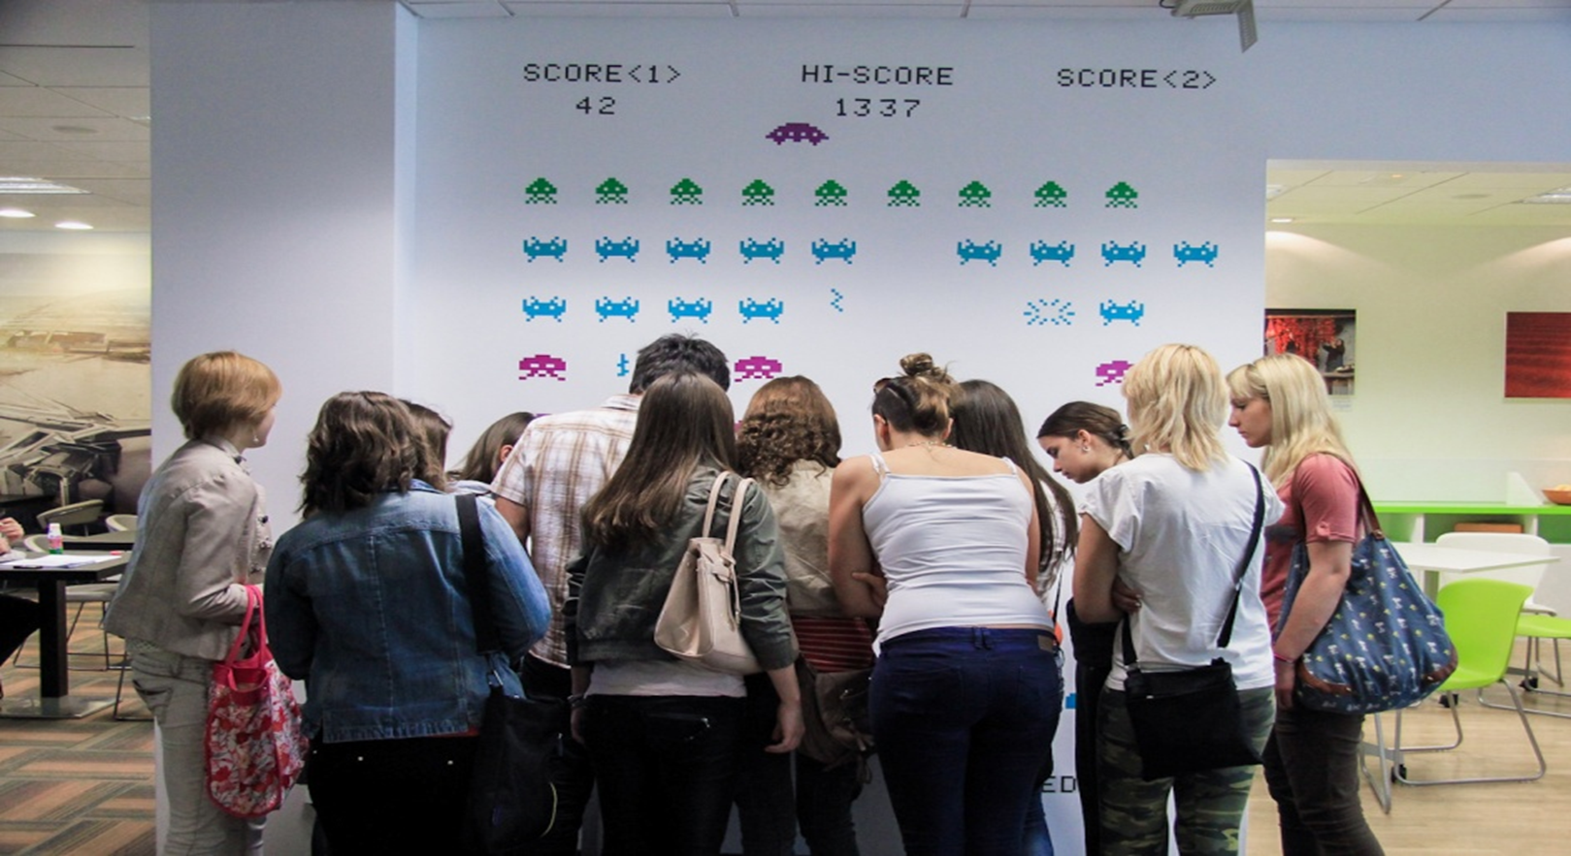
Notes:
About Girls day and Boys day: what is the point, who participate in it, how many young people participated this year, and so on… Give the example of good praxis, there are lots of them.

Slide 14
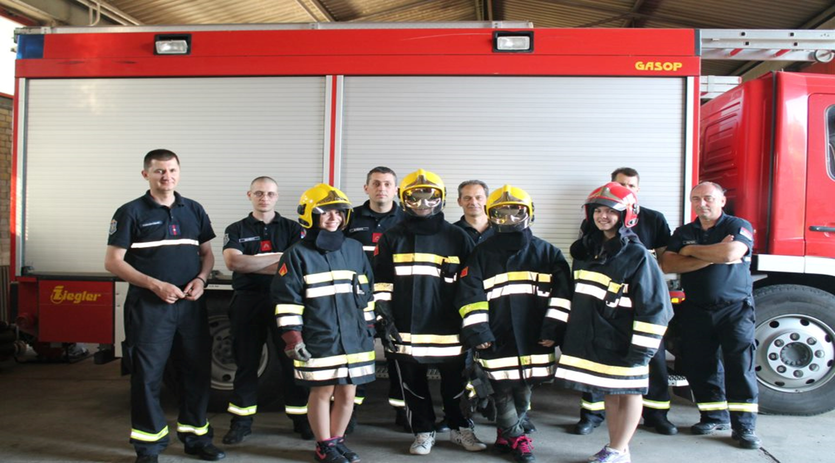

Slide 16
Thank you!
My contact:
E-mail: marija.radovanovic@giz.de
www.profesionalnaorijentacija.org
www.odskoledoposla.org

